Slide 1
Delayed Postoperative Intraocular Lens Opacification: Case report
Presenting Author: Dr. Neha Laspal, 2nd Year Resident
Co-Authors:
Dr . Kalpit P. Shah, Associate Professor
Dr . Sania Gulwani, Senior Resident
M & J Western Regional Institute of Ophthalmology, Ahmedabad
No financial or conflicts of interest

Slide 2
INTRODUCTION
Intraocular lens (IOL) opacification is an uncommon but irreversible complication of cataract surgery.
Infact, it has been reported as third most common cause for IOL explantation following IOL dislocation and incorrect IOL power.
Incidence of IOL opacification varies from 1.1% to 14.5% and duration for IOL to be opacified varies from as less as 1 year after the surgery to 7 years or longer.
The causes of opacification can vary from systemic conditions of patient, IOL biomaterials, IOL manufacturer, IOL storage, cataract extraction technique etc.
The patients often presents with reduced visual acuity with low contrast sensitivity in affected eye.

Slide 3
CASE REPORT:
MATERIALS & METHODS
CASE 1
A 66 years old female presented to OPD with complaints of diminution of vision in right eye for 2 years which was insidious in onset and was gradually progressive .
CASE 2
A 63 years old female presented with complaints of diminution of vision for 4 months which was progressive .
She had a history of right eye cataract surgery done 3 years back and left eye cataract surgery 2 months back.
No systemic illness was noted and not using any systemic or topical drugs.
She had a history of both eye cataract surgery 1.5 years back
No systemic illness was noted and not using any systemic or topical drugs.

Slide 4

Examination | Case1 | Case2
Best corrected visual acquity | RE-HM-PL+PR4+ LE-6/6 | RE-6/60 LE-6/9
Intraocular Pressure on Applanation Tonometry | RE -16mm of hg LE-14 mm of hg | RE-18 mm of hg LE-16mm of hg
Slit Lamp examination: Anterior segment examination | RE- Opacified IOL LE-Pseudophakic with clear IOL | RE-opacified IOL LE-Pseudophakic with clear IOL
Fundus examination | RE-details not seen LE-0.3 CDR ,FR dull | RE-Details hazily seen ,0.2 CDR ,FR dull LE-0.2 CDR ,FR dull
Ultasonography | Both eye- normal | Both eye- normal
Ultrasound biomicroscopy | Both eye-unremarkable | RE-mild fibrosis between IOL and anterior capsule margin LE-unremarkable
After complete evaluation, blood investigations and written consent ,both the cases were planned for IOL explantation with IOL exchange.

Slide 5
Surgical Technique:
Local peribulbar anesthesia was given .
Two sideports were made and anterior chamber filled with viscoelastic substances.
Main entry made with keratome 2.8mm.
Case 1-Intraoperatively entire optic and haptic of IOL was found opacified and there was fibrosis between IOL and bag. Attempt was made to separate IOL from bag with the help of viscoelastic substance. IOL explanted via main entry after enlarging the entry.
Bag dialysis was found and anterior vitrectomy performed and iris claw lens was placed.
Case2- Intraoperatively entire optic and haptic of IOL was found opacified .opacified IOL was found in sulcus and was explanted , foldable three-piece IOL was placed in sulcus.

Slide 6
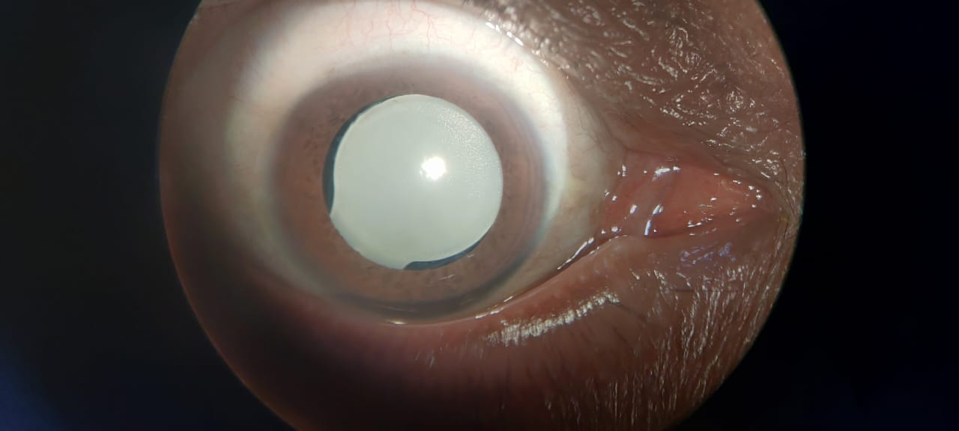
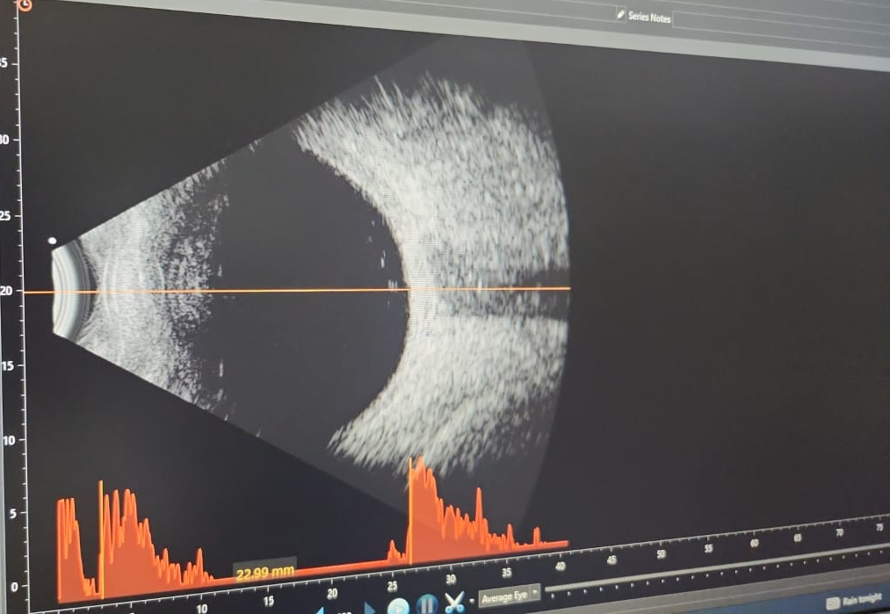
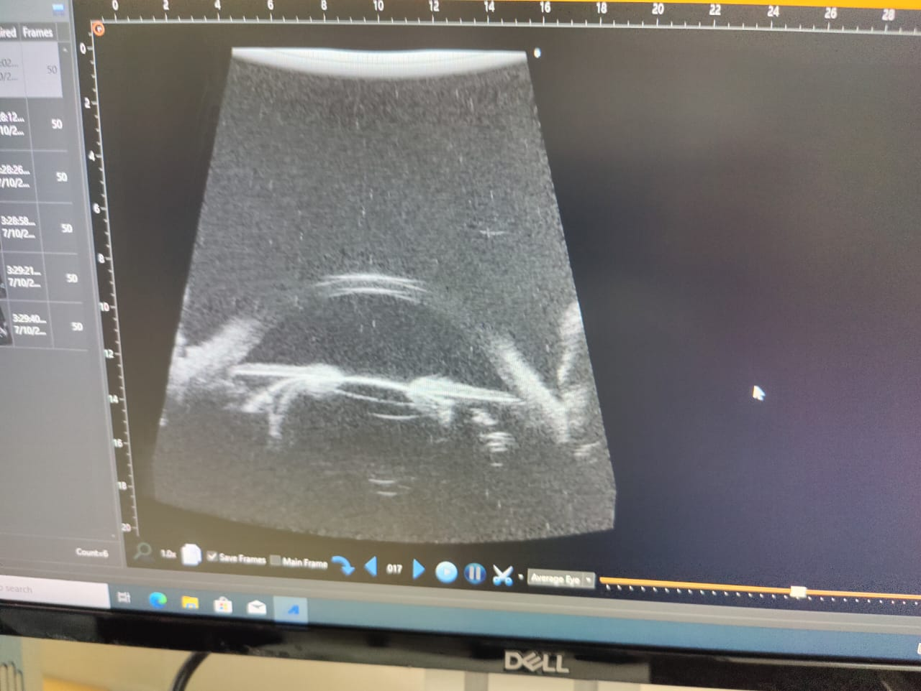
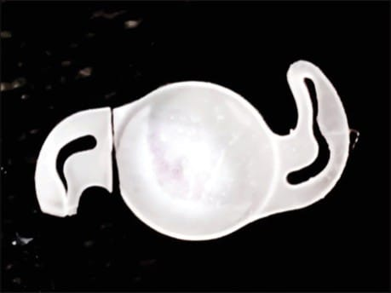
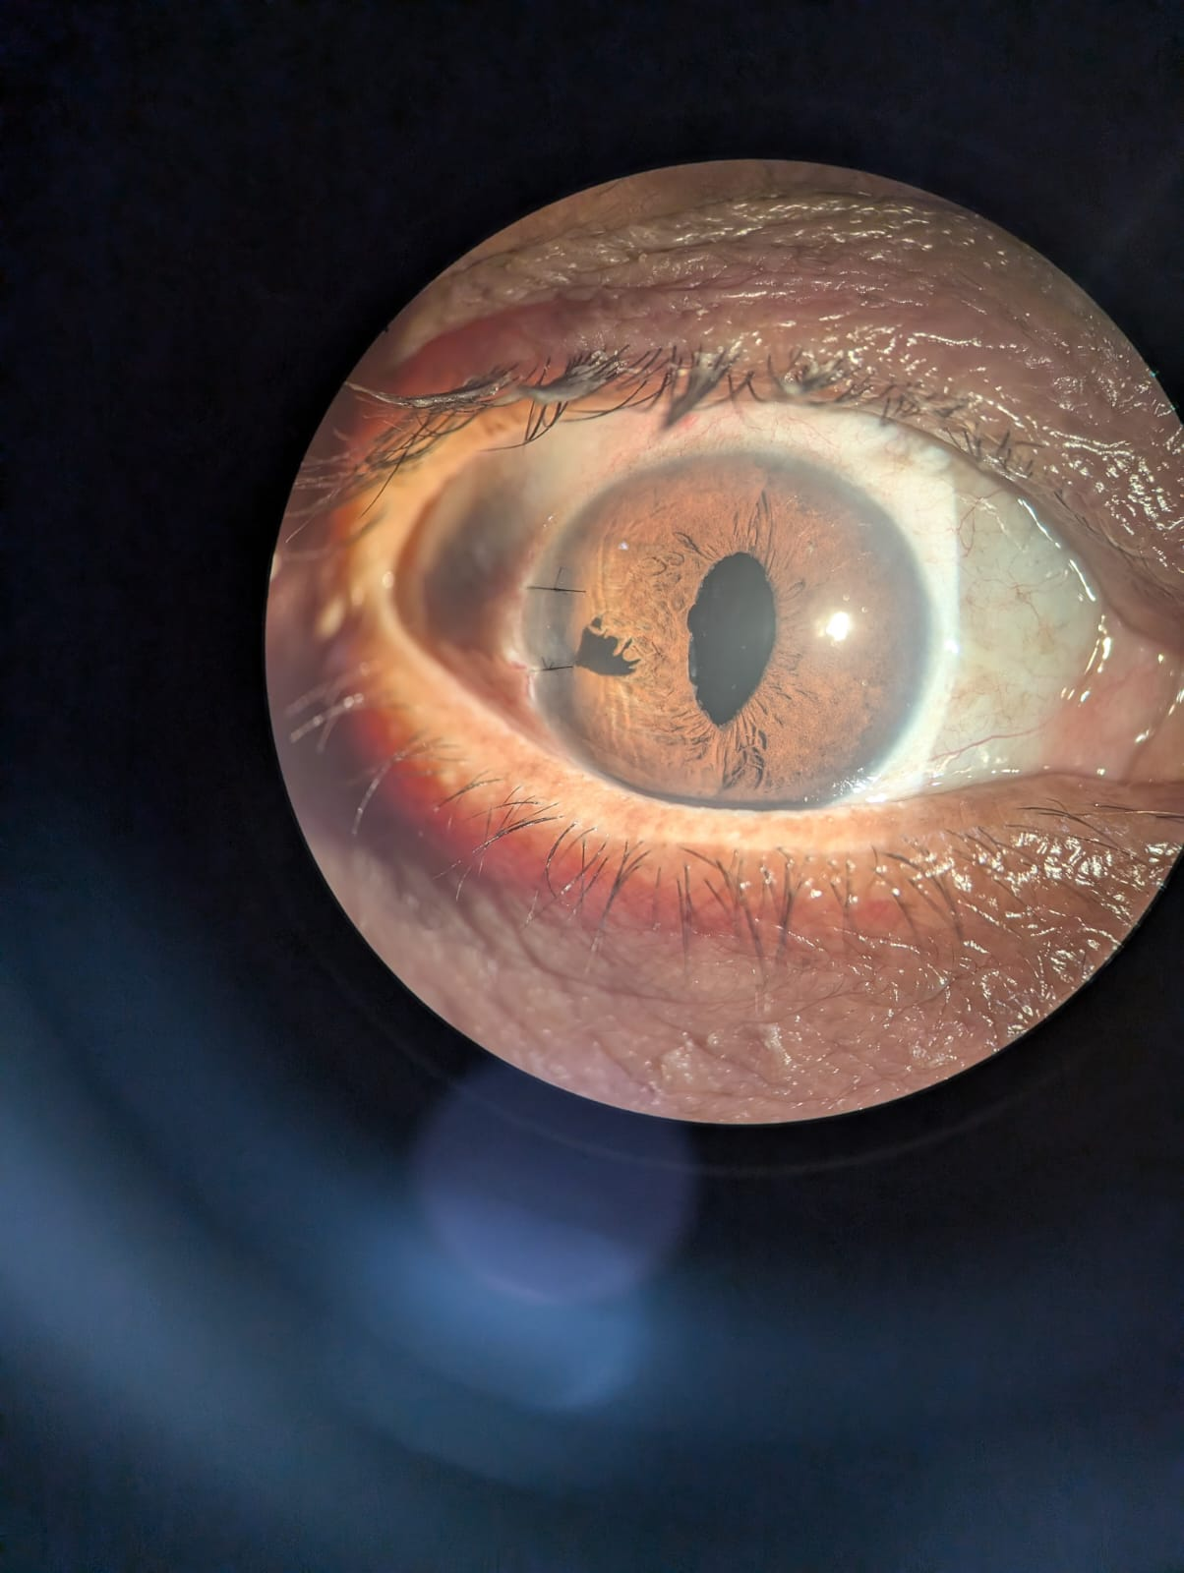
CASE 1
(a)
(b)
(c)
(d)
(e)
(a) Slit lamp photograph of right eye showing diffusely opacified intraocular lens
(b) B scan of right eye –normal finding
(c) Ultrasound bio microscopy of right eye showing thickened opacified lens.
(d) Photograph of explanted opacified IOL
(e) Postoperative slit lamp photograph of right eye.

Slide 7
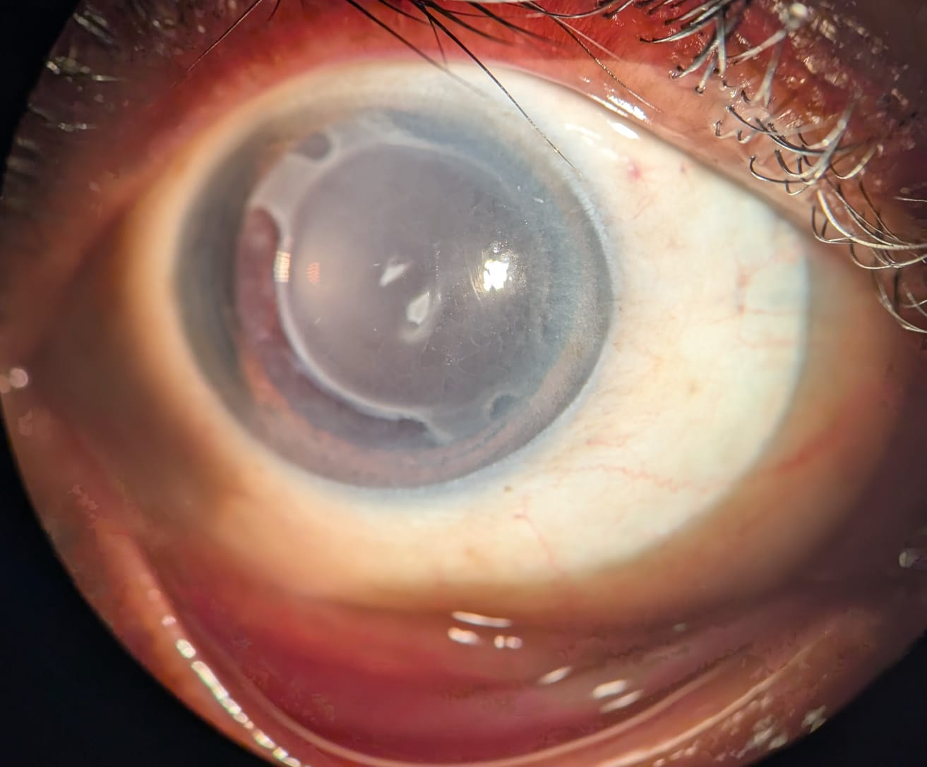
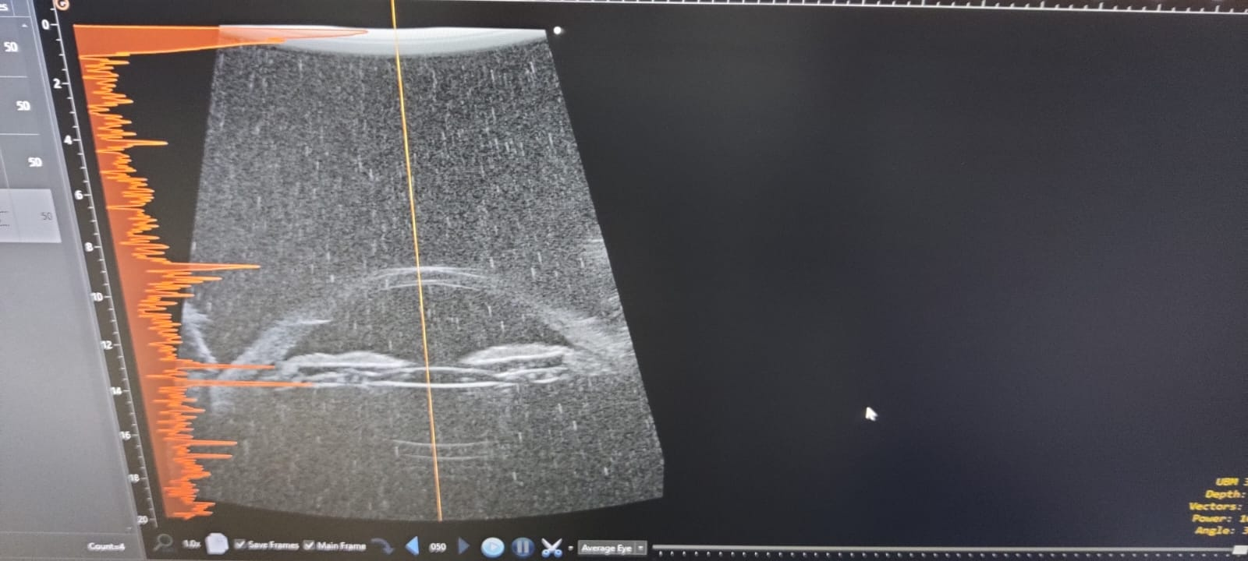
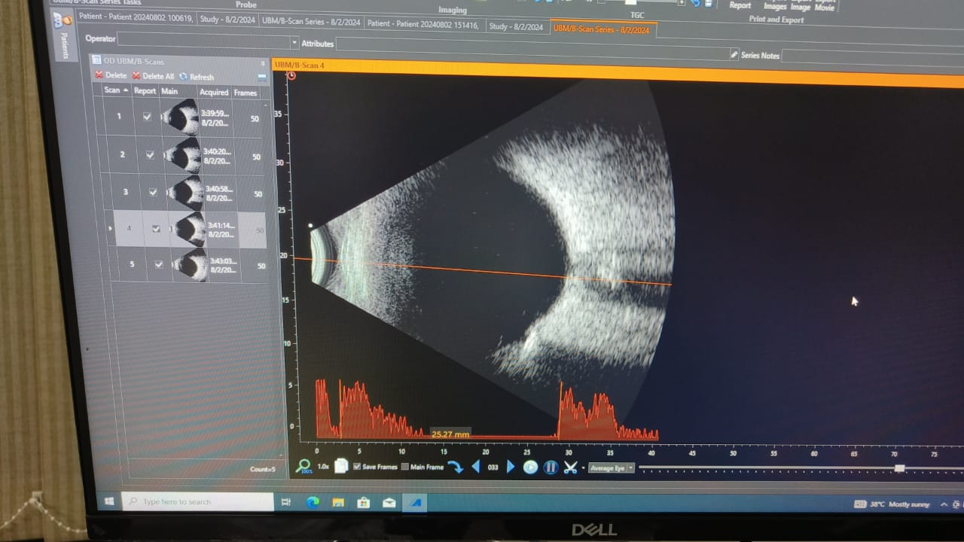
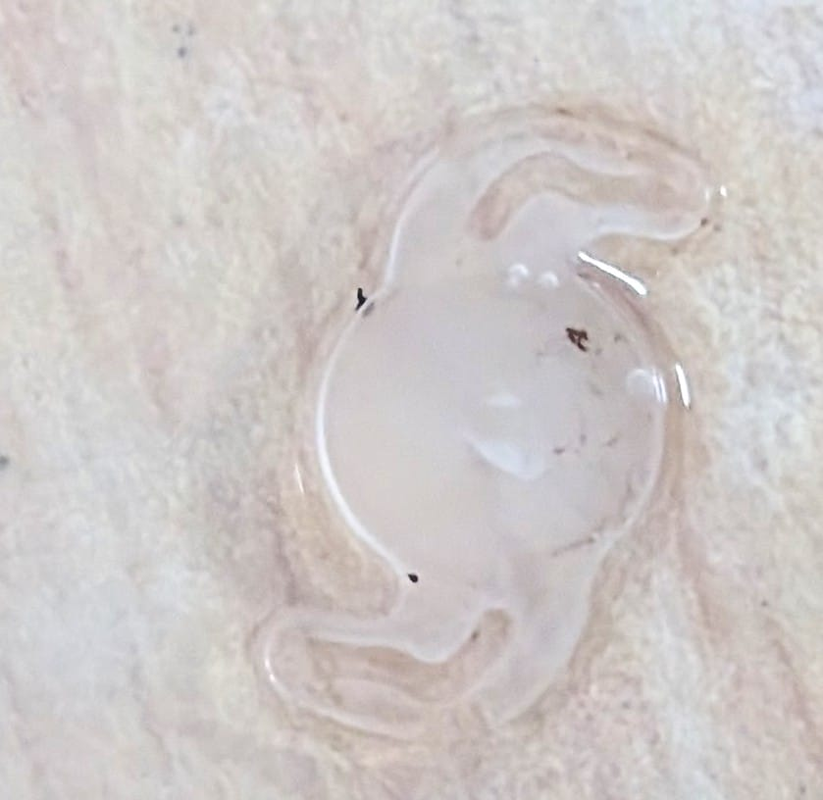
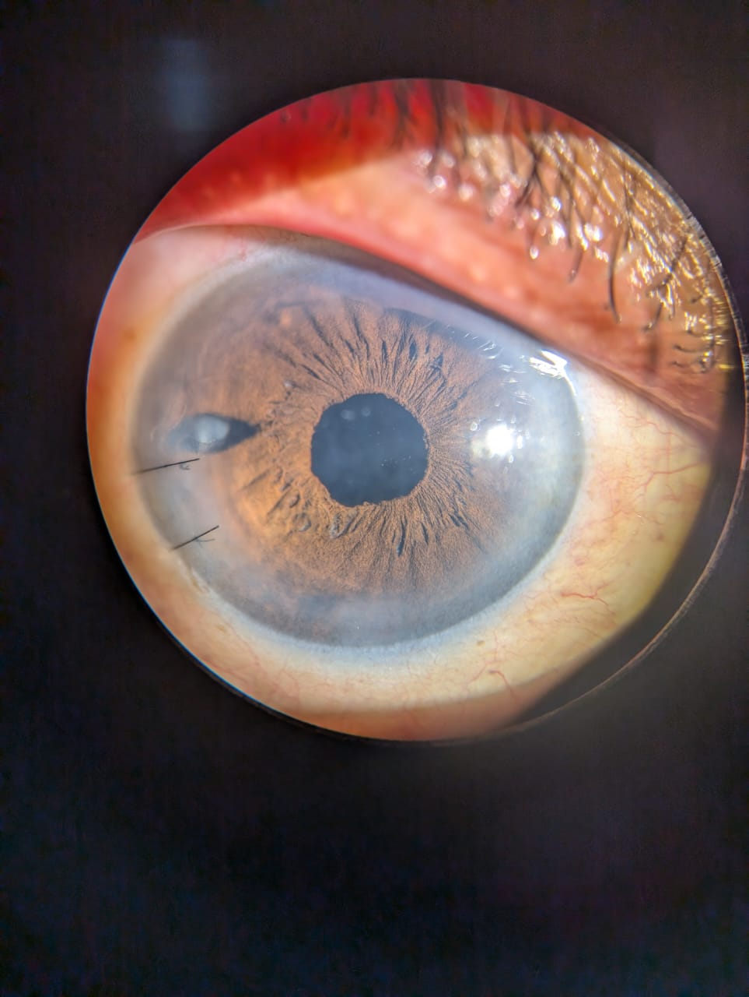
CASE 2
(a)
(b)
(c)
(d)
(d)
(e)
Slit lamp photograph of right eye showing diffusely opacified IOL
Ultrasound biomicroscopy photograph of right eye showing IOL in sulcus and fibrosis between haptic and anterior capsule rrhexis margin
B scan of right eye showing normal findings
Photograph of explanted IOL
Postoperative Slit lamp photograph of right eye.

Slide 8
RESULT:
On Postoperative Day 1
Case 1-
Uncorrected vision
RE- Counting fingers 3m
IOP : RE-10mm of hg
Slit lamp findings:
RE - Mild corneal edema +
Routine Topical postoperative medications-moxifloxacin, dexamethasone, nepafenac eye drops advised.
Follow up visit( 1 week)
BCVA -6/6(-1.50*95)
IOP -12mm of hg
Corneal edema resolved.
On Postoperative Day 1
Case 2-
Uncorrected vision
RE-6/60
IOP : RE-12mm of hg
Slit lamp findings:
RE - mild corneal edema +
Routine Topical postoperative medications-moxifloxacin, dexamethasone nepafenac eye drops advised.
Follow up visit( 1 week)
BCVA -6/6(-0.75*90)
Iop -14mm of hg
Corneal edema resolved.

Slide 9
DISCUSSION:
IOL opacification is an infrequent and often delayed postoperative complication of cataract surgery.
The exact causes and the underlying mechanisms are still under investigation and believed to be multifactorial.
There have been few reports regarding late postoperative opacification of IOL, the majority of them were hydrophilic acrylic material.
Some studies have shown late opacification of IOL attributable to calcium deposition.
The definitive management is explantation of opacified IOL followed by implantation of a new IOL.
It is vital to differentiate IOL opacification from Posterior capsule opacification (PCO) as therapeutic procedure for PCO such as posterior capsulotomy with Nd:YAG laser, disturb the capsular bag and make explantation of opacified IOL and implantation of new IOL in capsular bag difficult .In addition it subject the patients to an unnecessary procedure which is not exempt from complications.

Slide 10
CONCLUSION:
IOL opacification can be one of the rare differential diagnosis for delayed diminution of vision postoperatively.
IOL opacification possess challenges in diagnosis as it can be mistaken for posterior capsule opacification.
Clinical identification and complete evaluation is important before planning any intervention.
IOL exchange can restore vision owing to IOL opacification in most cases though it can be associated with a high incidence of complications.
In summary, correct diagnosis of this complication followed by appropriate management is crucial for effective treatment.

Slide 11
References:
1. Balasubramaniam C, Goodfellow J, Price N, Kirkpatrick N. Opacification of the Hydroview H60M intraocular lens: Total patient recall. Journal of Cataract and Refractive Surgery. 2006 Jun 1;32(6):944–8.
2. Neuhann T, Yildirim TM, Son HS, Merz PR, Khoramnia R, Auffarth GU. Reasons for explantation, demographics, and material analysis of 200 intraocular lens explants. Journal of Cataract & Refractive Surgery. 2020 Jan 1;46(1):20-6.

Slide 12
THANK YOU
......

